Slide 1
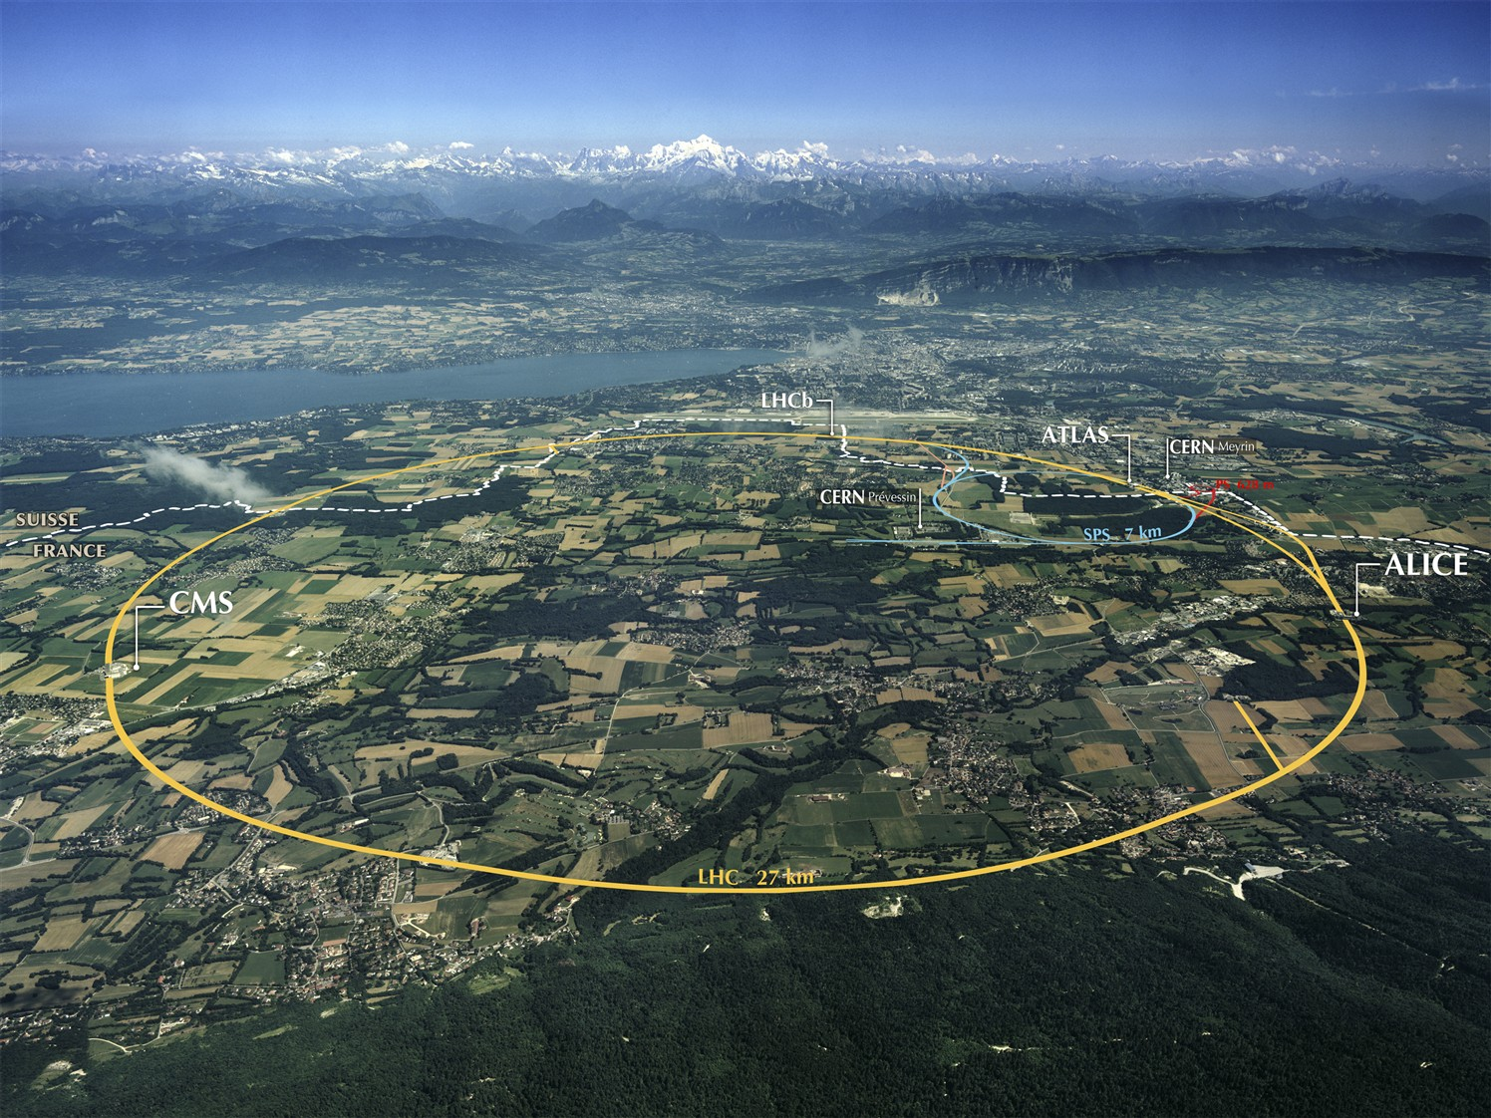
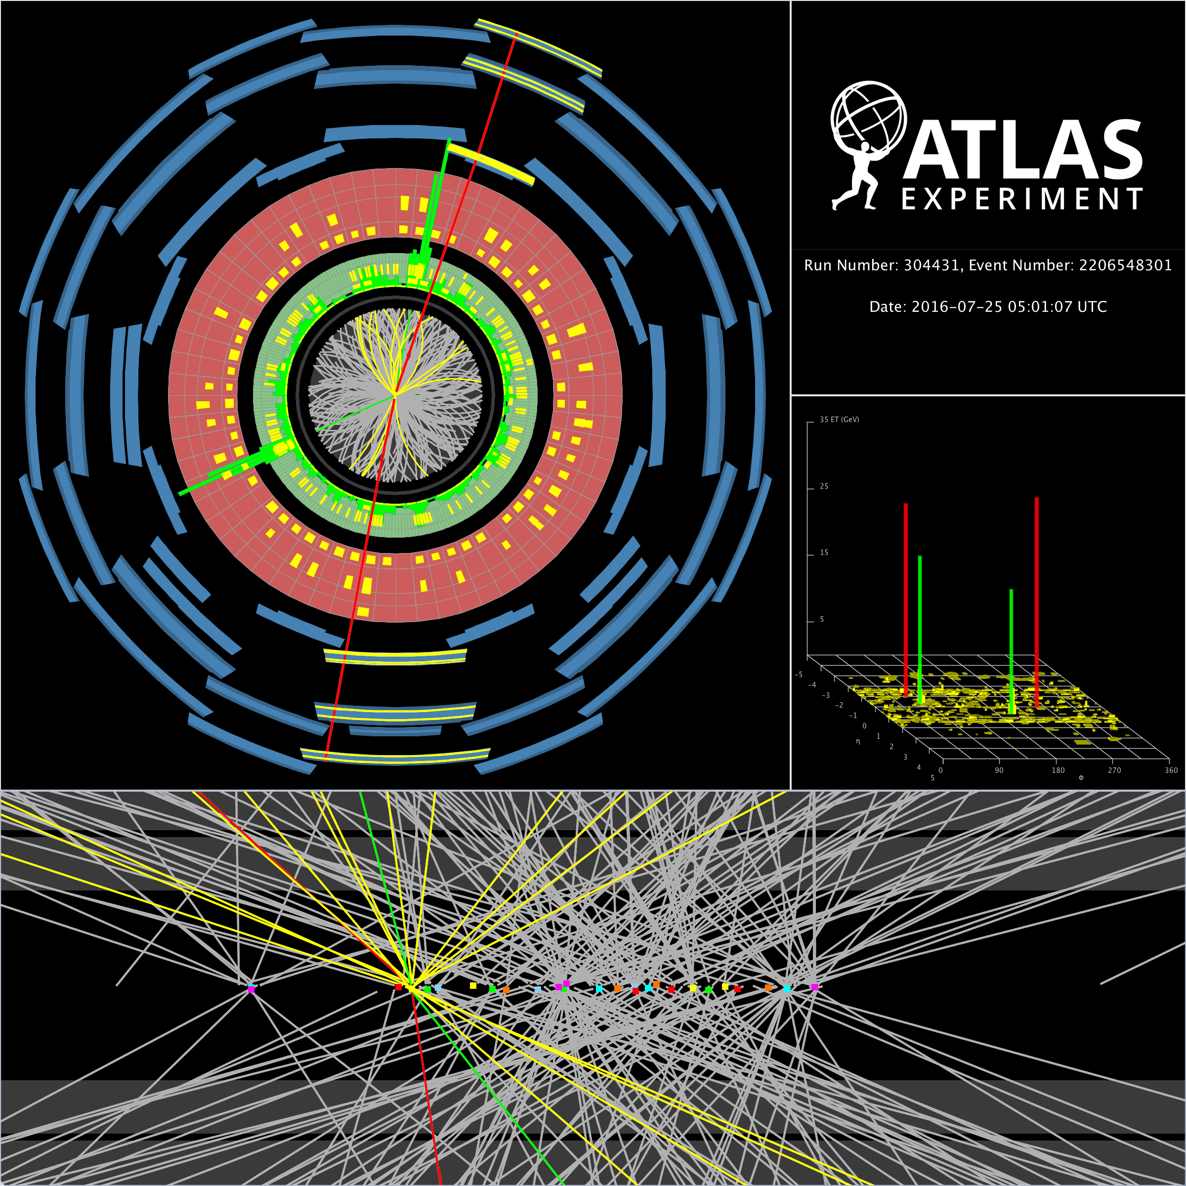


CERN and the
ATLAS Experiment
Karl Jakobs
ATLAS Spokesperson
University of Freiburg / Germany
7th ATLAS Induction Day
21 October 2019
Karl’s avatar

Slide 2
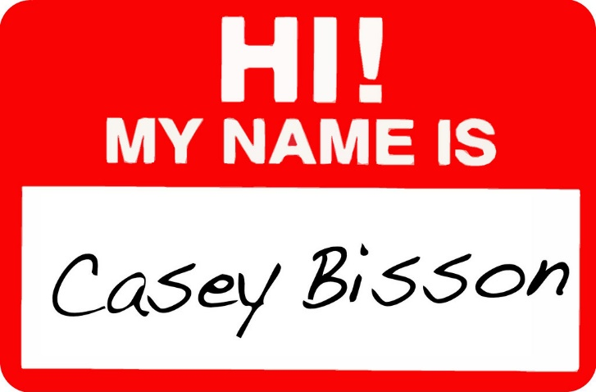
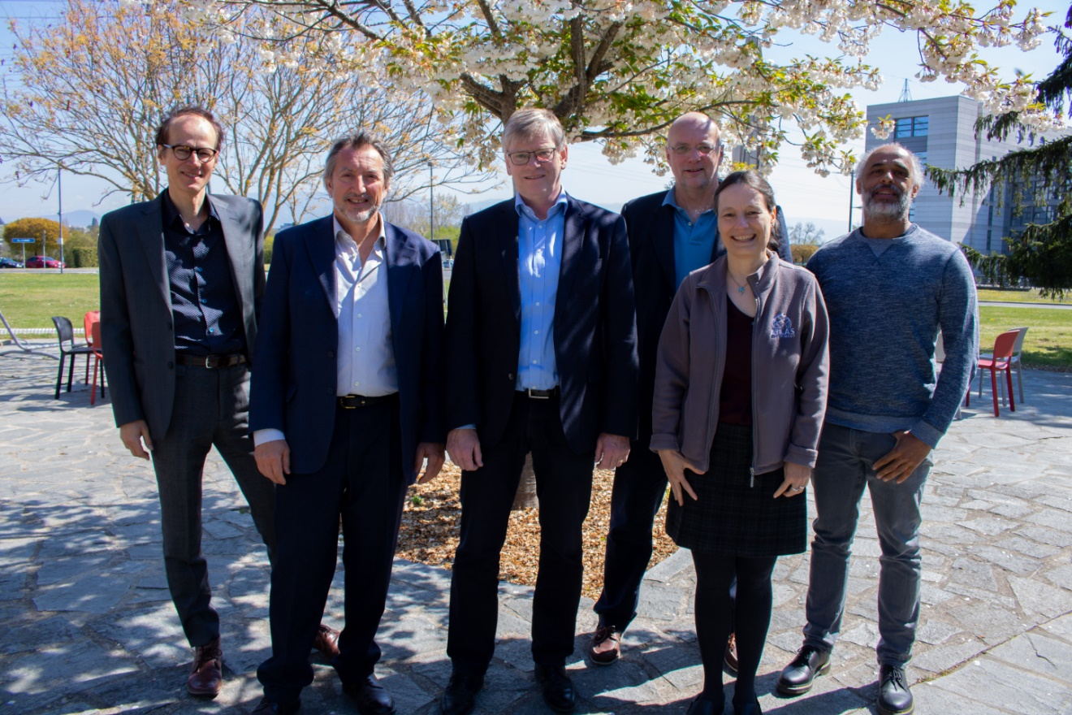

Manuella G. Vincter (Carleton University)
I am a Professor of Physics at Carleton University in Ottawa, Canada
I was Associate Chair for my Physics Department looking after graduate student affairs.
I’ve worked with a lot of graduate students!
I am an ATLAS Deputy Spokesperson
I’m into SM W&Z, e/γ CP, and my heart is in LAr (but I have no time)…
Manuella
ATLAS Management Team
ATLAS Management Team
for inviting me to your induction!
My door (40/4-D32) is open if you have questions or concerns.
Me!

Slide 3
CERN and the
ATLAS Experiment
CERN
Towards the LHC and the ATLAS experiment
The future of ATLAS
Some Physics Highlights
The ATLAS Collaboration today

Slide 4
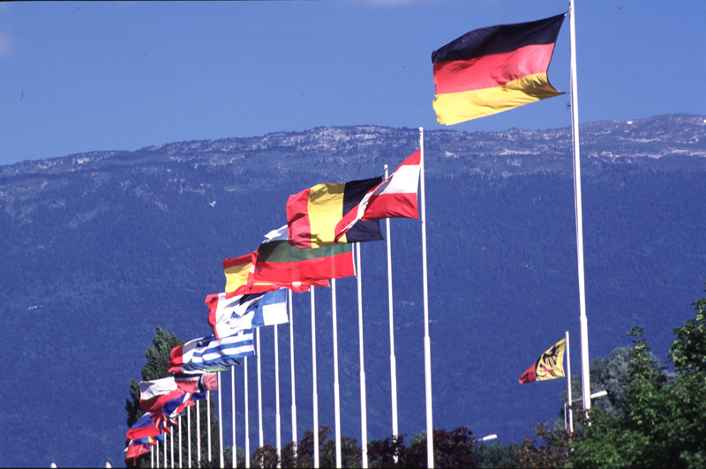

CERN
A Paradigm for European Cooperation
Notes:
CERN
Als europäische Institution
Gründungsgeschichte im kalten Krieg
Europa durch Bündelung der nationalen Kräfte unangefochten Weltspitze

Slide 5
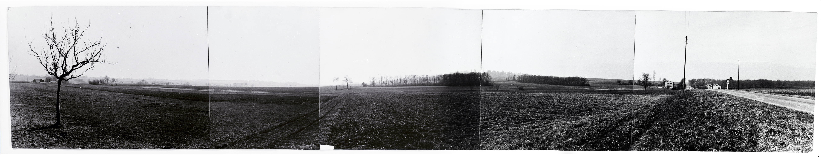
CERN
Objective: Creation of a powerful and competitive infrastructure for fundamental research
in nuclear / particle physics in Europe
Science has played a vital role in unifying the planet: successes possible through scientific cooperation and collaboration
based on a unanimously adopted UNESCO resolution in 1951
1952: Creation of a Council: "Conseil Européen pour la Recherche Nucléaire“
Belgium, Denmark, France, Germany (West), Greece, Italy, The Netherlands,
Norway, Sweden, Switzerland, United Kingdom, Yugoslavia
Coming into force of the convention on 29th September 1954:
Foundation as "Organisation Européenne pour la Recherche Nucléaire“
“Panorama” photograph taken around 1954 of the site that would become the CERN laboratory. © 1954-2019 CERN

Slide 6
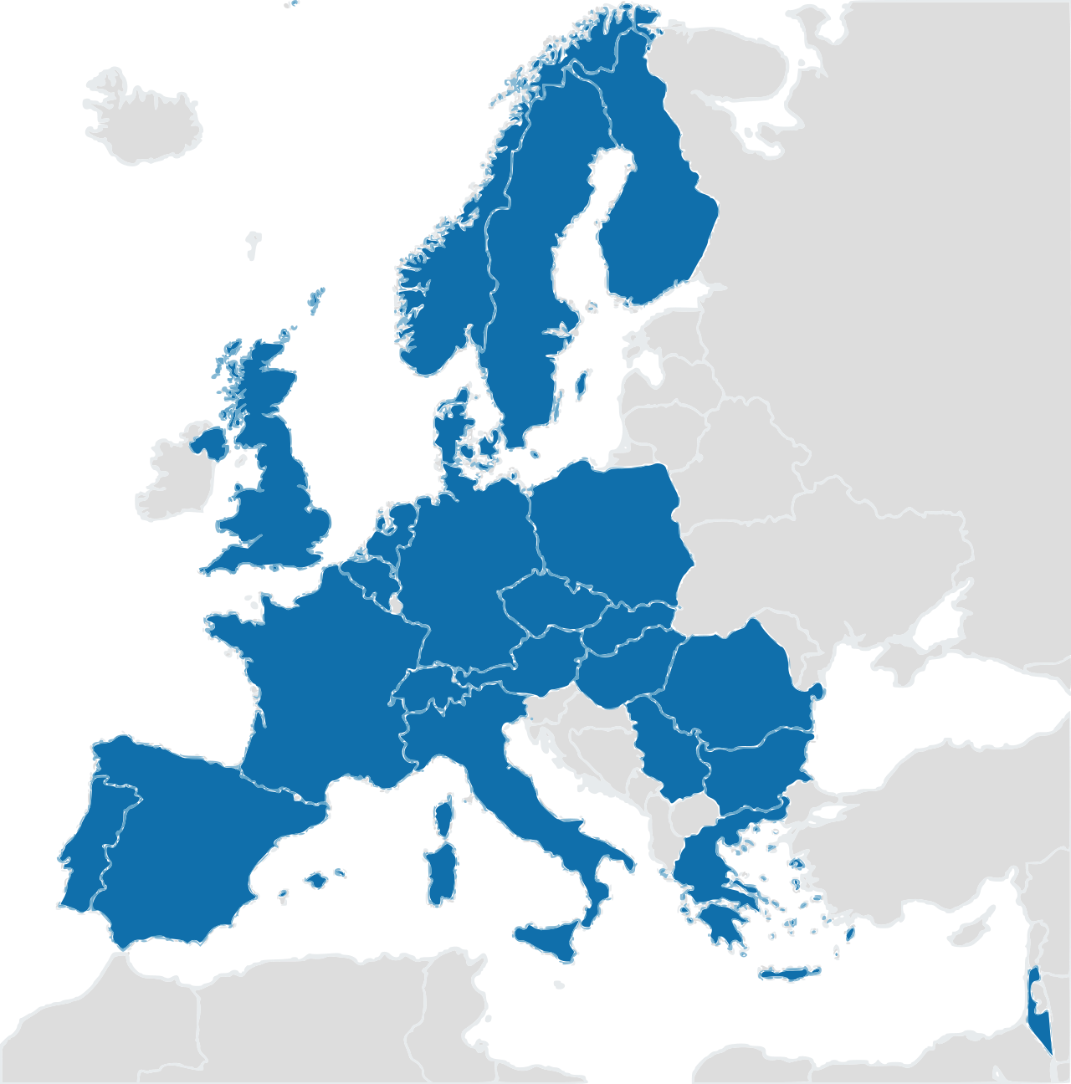
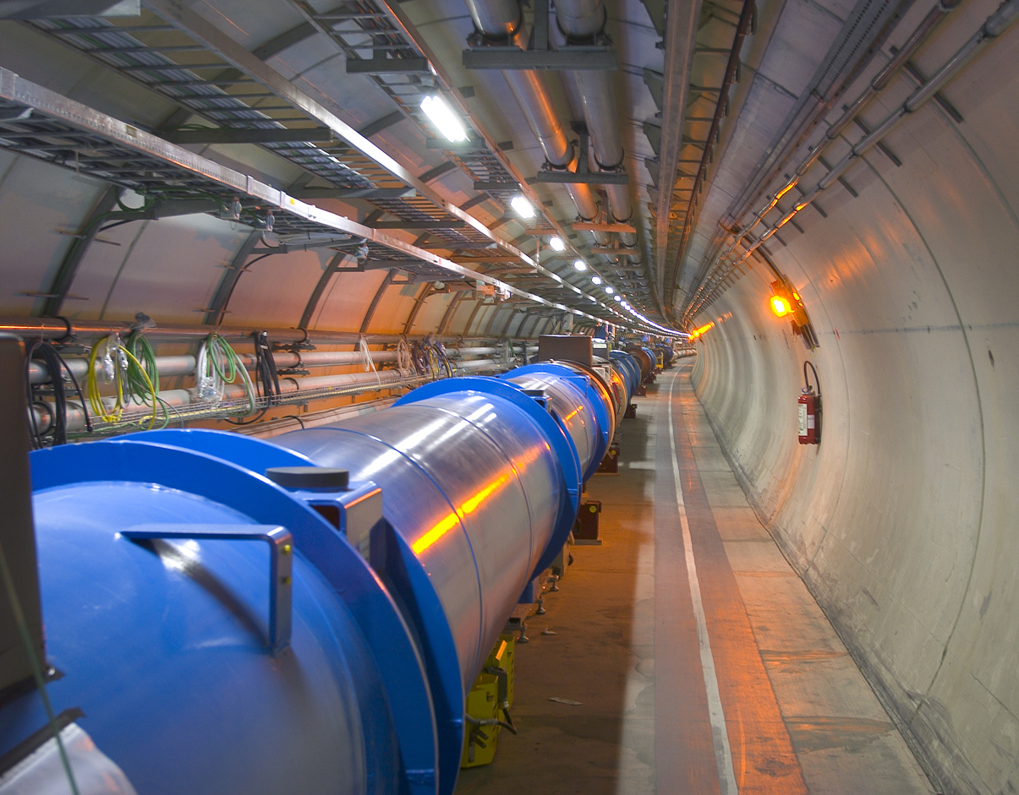
CERN today
23 Member states
+ associated members
2500 Staff members
(Scientists, engineers, technicians, ...)
1800 Other paid personnel
13000 Scientific users
(Universities and Research Institutes)
World-largest research centre for fundamental physics
Budget (2017): ~1100 Mio CHF
World’s most powerful system of particle accelerators

Slide 7
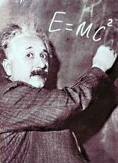
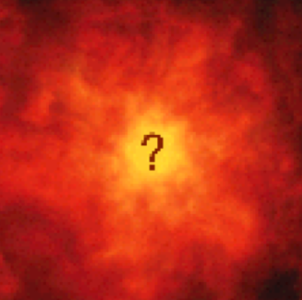

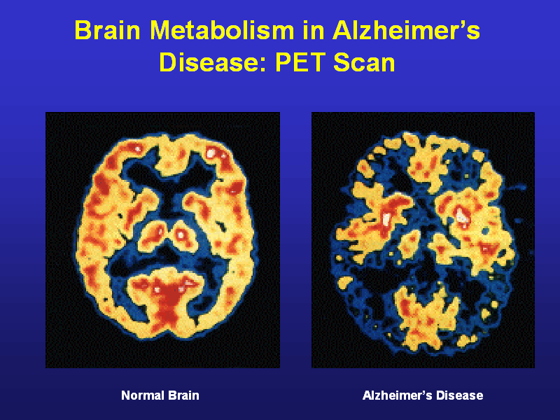
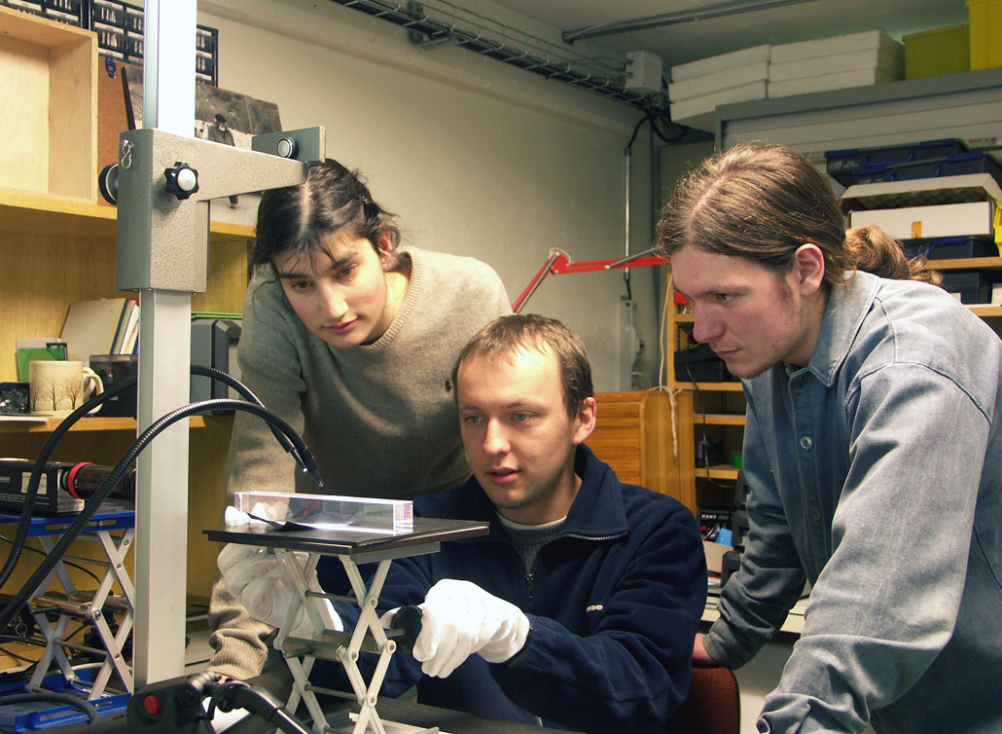
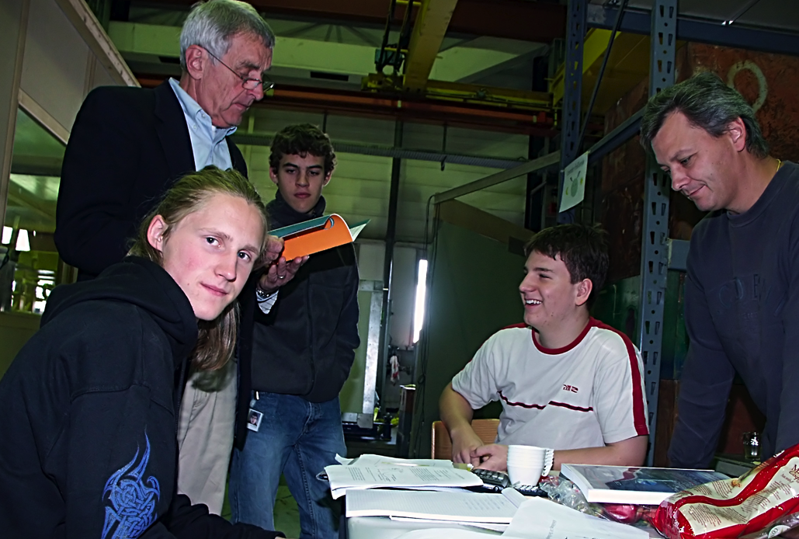
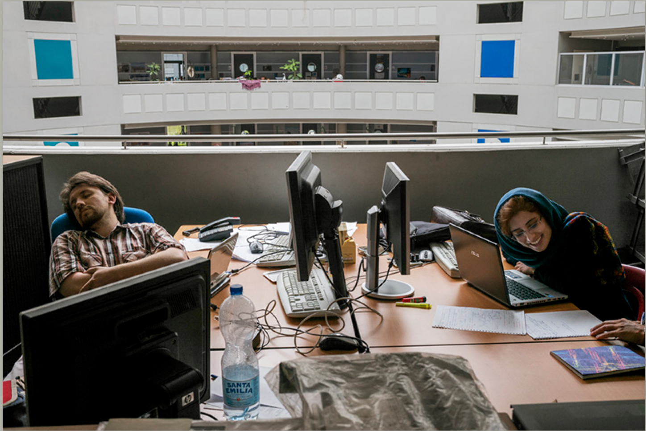
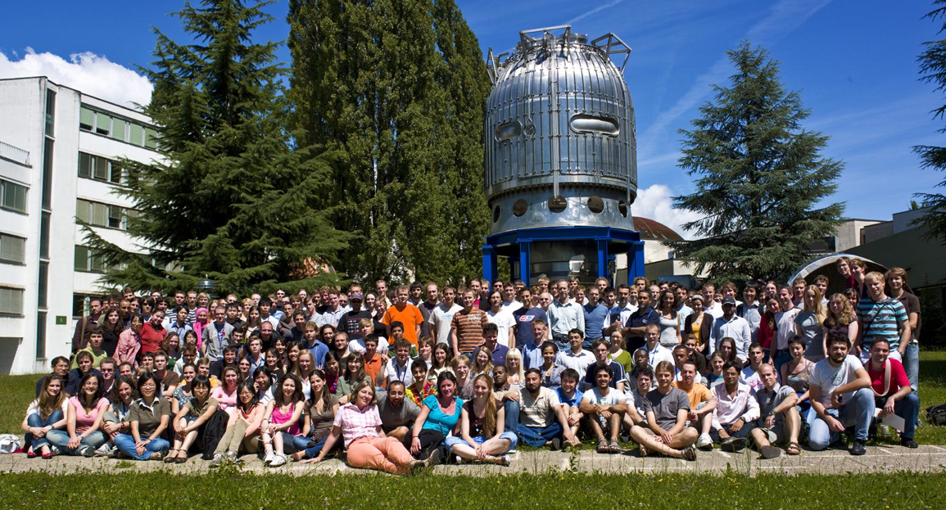
The mission of CERN
Push forward the frontiers of knowledge
Develop new technologies for accelerators
and detectors
Accelerators, detectors, data handling, ...
Train scientists and engineers of tomorrow
in an international and leading-edge environment
important training centre for PhD students
Unite people from different countries
and cultures
Notes:
7

Slide 8
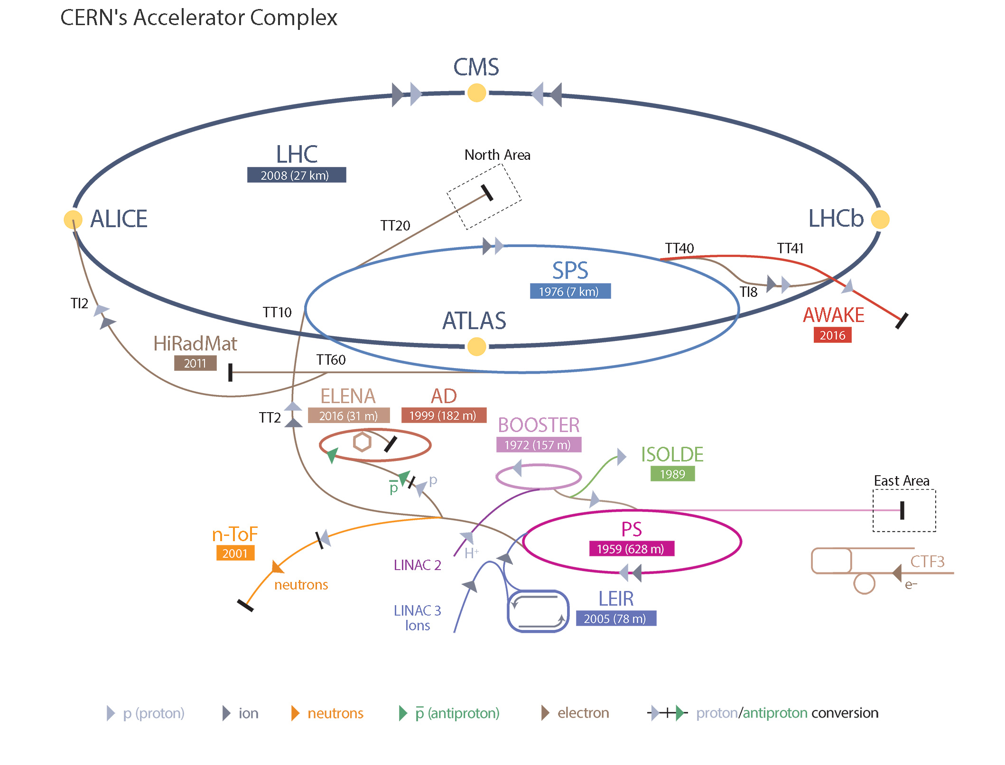

The CERN accelerator complex

Slide 9
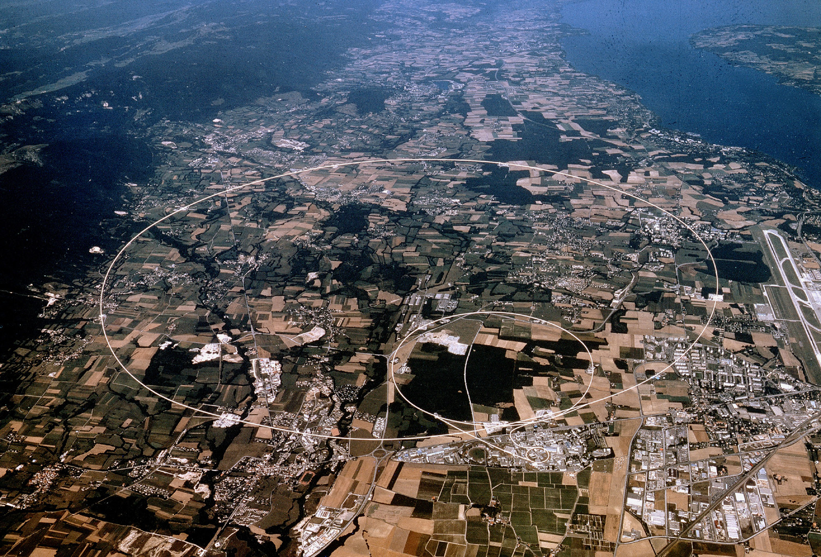
The Large Hadron Collider
Notes:
9

Slide 10
The role of the LHC (~1990)
1. Explore the TeV mass scale
- What is the origin of the electroweak symmetry breaking ?
Does the Higgs boson exist?
- The search for “low energy” supersymmetry
Can a link between SUSY and dark matter be established?
- Other scenarios beyond the Standard Model
- …….
Look for the “expected”, but be open for surprises
→ perform as many searches (inclusive, exclusive…) for as many final states
as possible
Precision tests of the Standard Model
- and is much sensitivity to physics beyond the Standard Model in the precision area…
- … in addition: many Standard Model measurements can be used to test and to tune
the detector performance, improve the modelling of our generators etc…

Slide 11
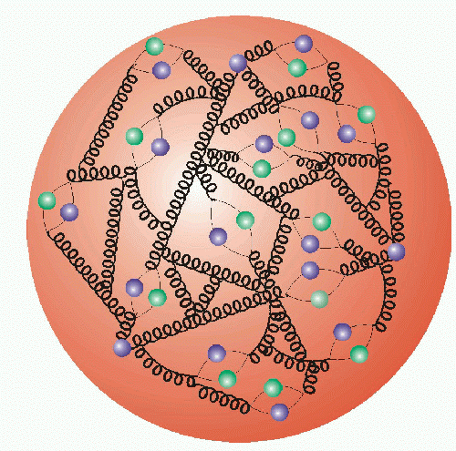
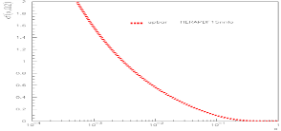
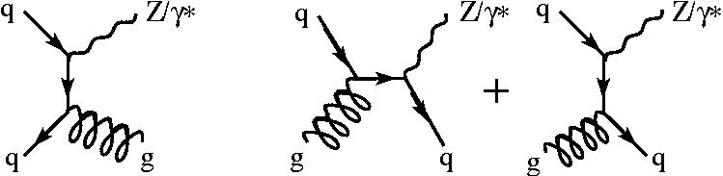
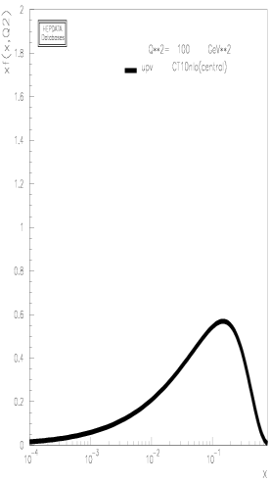
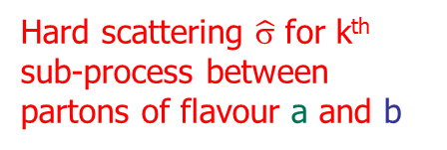
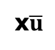
Proton-proton collisions at the LHC
Z/γ*
Parton distribution functions f of the proton (pdf)
x₁,x₂ = momentum fraction of partons
q,g
x$\overline{u}$
u
xu_{v}
u
Z/γ*
g
10⁻⁴ 1
x₁
(+ other diags…)
x₂
10⁻⁴ 1
q
q
Hard scattering $\hat{σ}$ for k^{th} sub-process between partons of flavour a and b
σ=$\sum_{a,b,k}{∫dx1dx2 fa(x1,Q2){ \hat{σ}}_{a,b,k}^{}(x_{a},x_{b})} fb(x1,Q2)$
Thanks to:
desy.de, hepdata.cedar.ac.uk

Slide 12
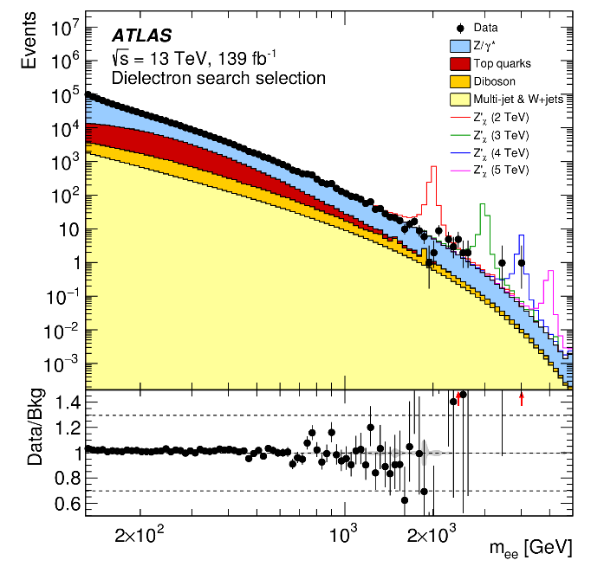
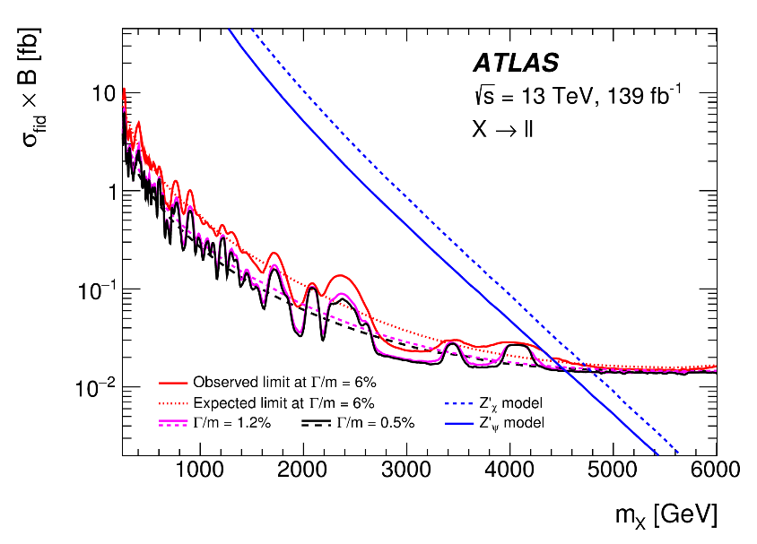
Beyond the SM?
??
New Physics
Processes?
e⁺
Z’
e.g. searches for new dilepton resonances
e⁻
lower limits on the resonance mass reach ~4.5TeV
arXiv:1903.06248

Slide 13
Important design considerations for the LHC (around 1990):
“The new machine must be capable to explore the full mass range up to the
TeV mass scale. The question of the existence of the Higgs boson must be
clarified, i.e. the detectors must have a discovery potential over the full mass
range up to 1 TeV”
To reach this goal with the given ring of 27 km and the centre-of-mass energy
in the range of 14-16 TeV, required very high luminosities of the order of
10³⁴ cm⁻² s⁻¹
This required a huge programme on detector research and development
Theoretical view at the time: No Loose theorem
“The LHC will either discover the Higgs boson, or new physics, or both”

Slide 14
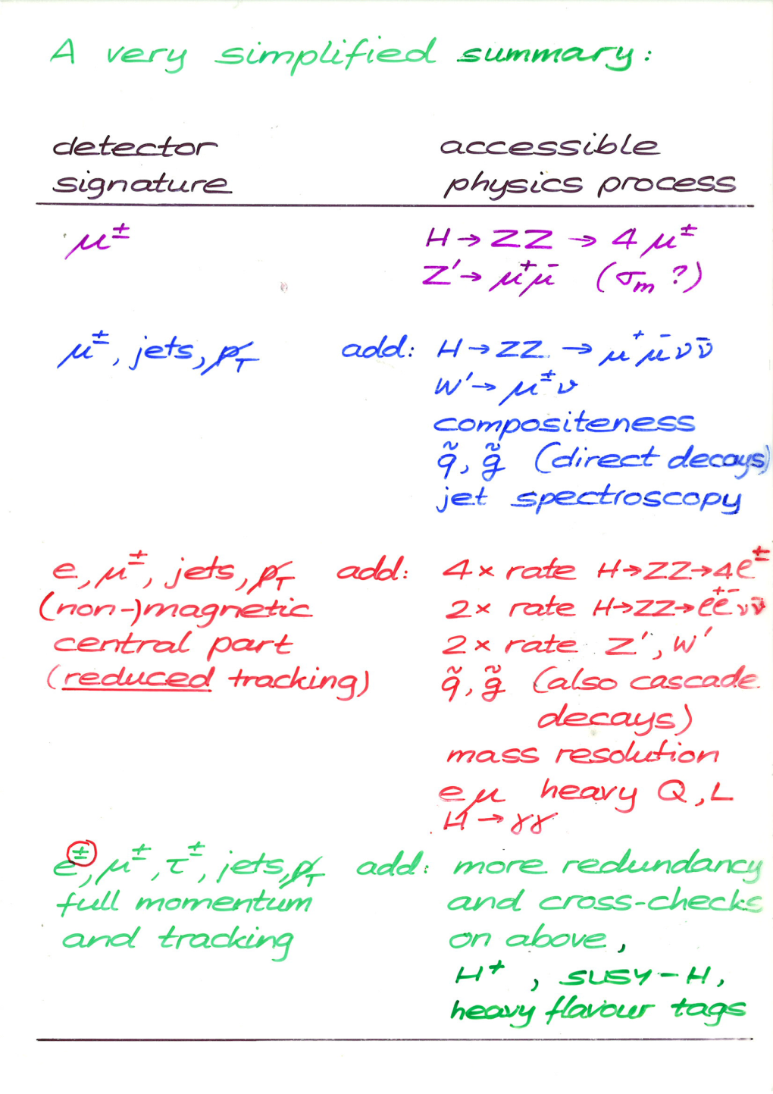
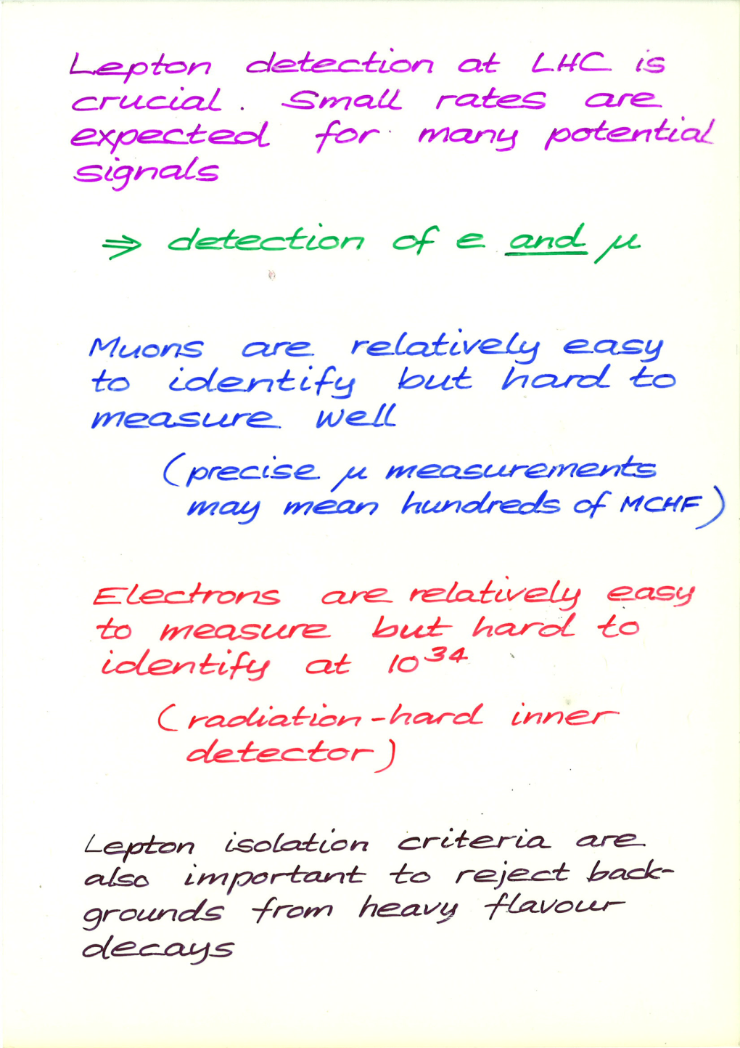
Arguing in the 1980s about designing an ambitious multi-purpose detector
Peter Jenni

Slide 15
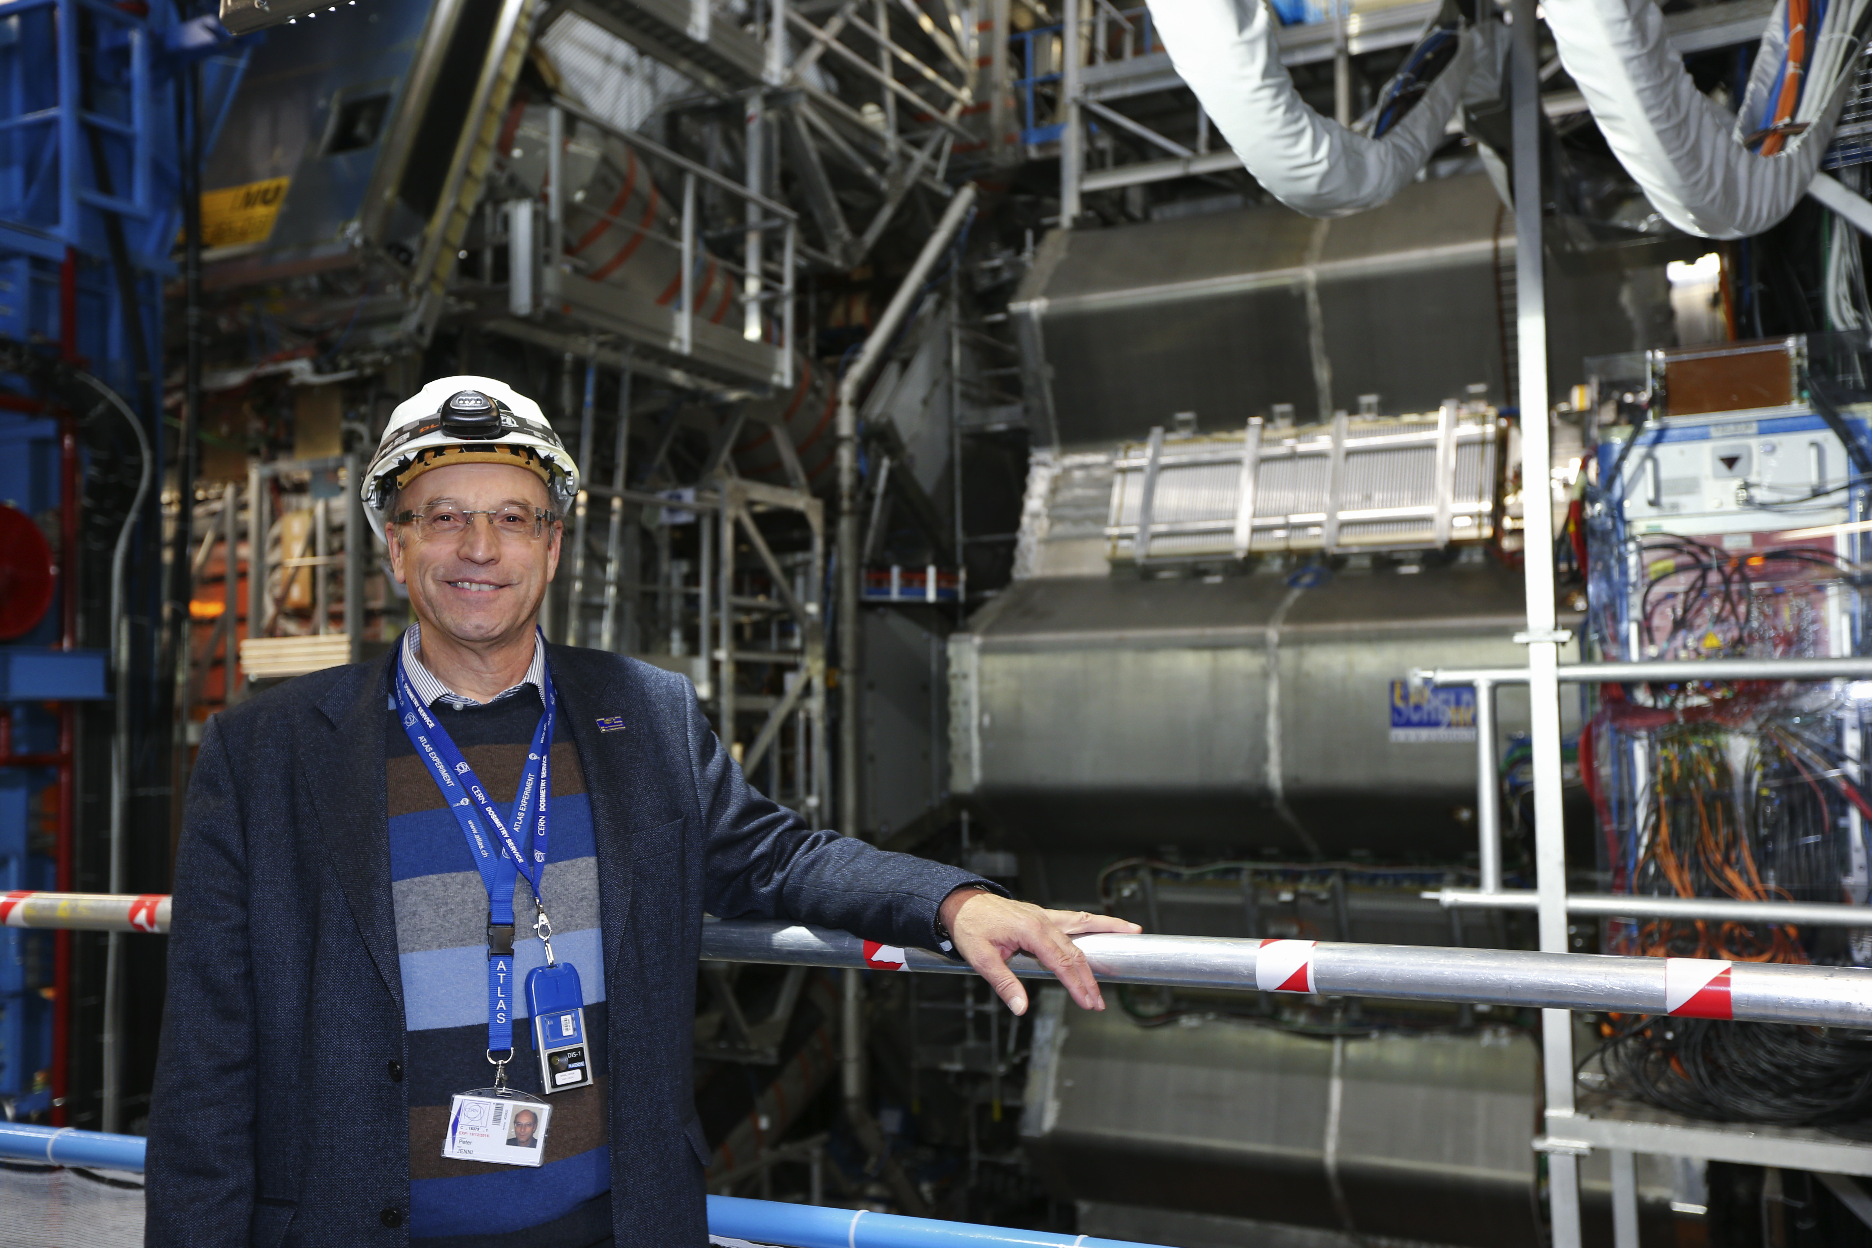
Arguing in the 1980s about designing an ambitious multi-purpose detector
Peter Jenni

Slide 16
1984 For the community it all started
with the CERN - ECFA Workshop
in Lausanne on the feasibility of
a hadron collider in the future
LEP tunnel
1986 LAA (Italian project) R&D on new
detector technologies started, later
followed by the DRDC
(Detector Research & Development Committee)
1987 La Thuile Workshop
Many LHC colleagues were already involved
in this WS set up by Carlo Rubbia as part of the
Long Range Planning Committee
1989 ECFA Study Week in Barcelona for
LHC instrumentation
1990 Large Hadron Collider Workshop
Aachen (CERN - ECFA)
1992 CERN – ECFA meeting ‘Towards the LHC
Experimental Programme’ in Evian

Slide 17
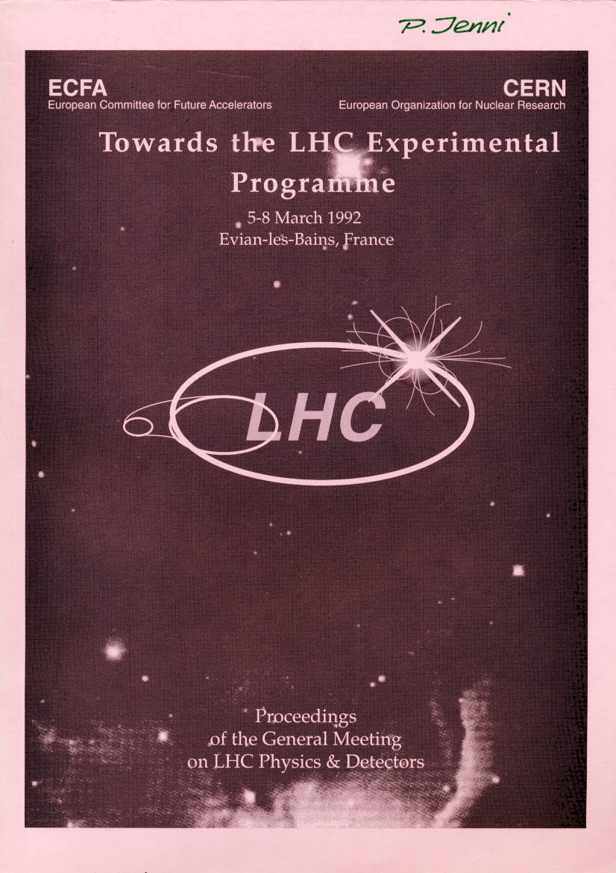
March 1992
Evian Meeting with presentations of the Expressions of Interest (EoI)
ASCOT pp P. Norton
CMS pp M. Della Negra / H. Desportes
EAGLE pp P. Jenni
L3+1 pp S. Ting, F. Pauss
LHC Beauty Collider P. Schlein
B extracted beam G. Carboni
B gas jet T. Nakada
Neutrino at LHC F. Vannucci
LHC HI J. Schukraft
DELPHI LHC HI G. Jarlskog

Slide 18
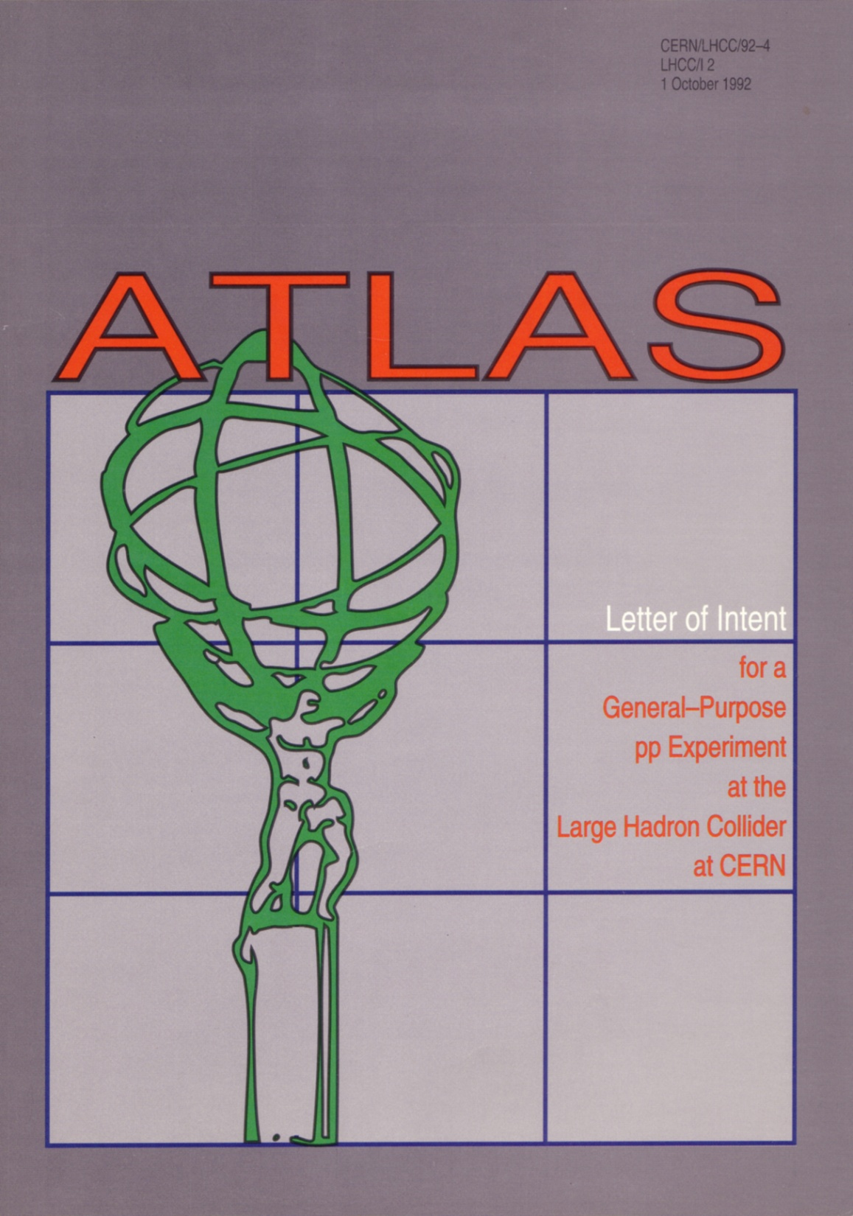

The birth of ATLAS
March 1992 – Summer 1992
Merging of EAGLE and ASCOT
September 1992: Decision on the name
1st round 2nd round
ATLAS 31 ATLAS 40
ALICE 12 ALICE 13
ACE 5
ALEX 5
LHD 0
1st October 1992
ATLAS Letter of Intent (LoI) submitted to the LHCC
‘Official birth of the ATLAS
Collaboration’
+2

Slide 19

ATLAS was invited by the
LHCC (review committee
for LHC) to work out a
Technical Proposal
(Submitted on 15th December 1994)

Slide 20

… followed by an impressive series
of Technical Design Reports (TDRs)
The formal construction approval was
then given with the approval of the first TDRs, namely for the calorimeters

Slide 21
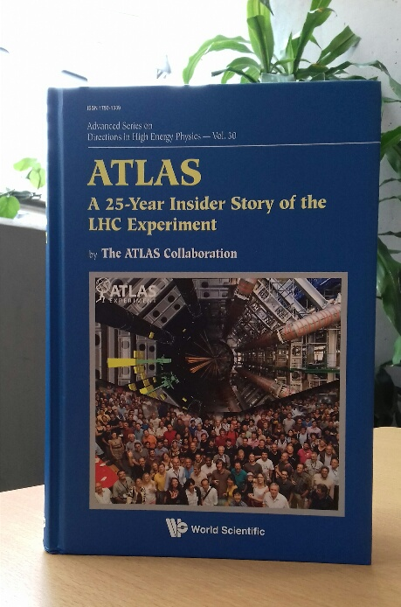
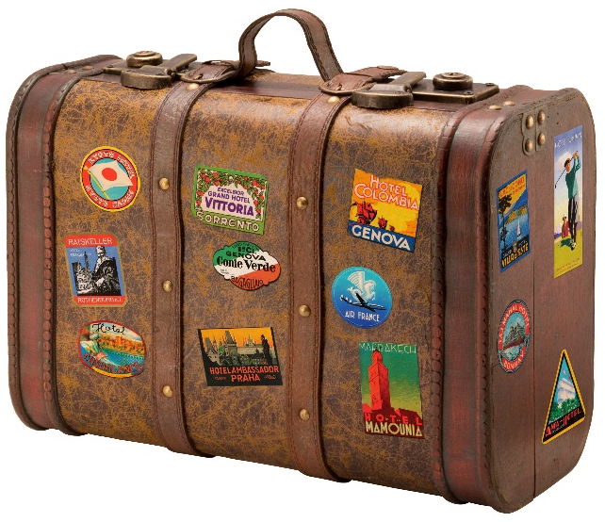


Interested in ATLAS history?
ATLAS 25th anniversary book
Take a journey through time for just 20CHF…
Visit the secretariat to get your copy!
Or see it online for free at:
https://www.worldscientific.com/worldscibooks/10.1142/11030

Slide 22

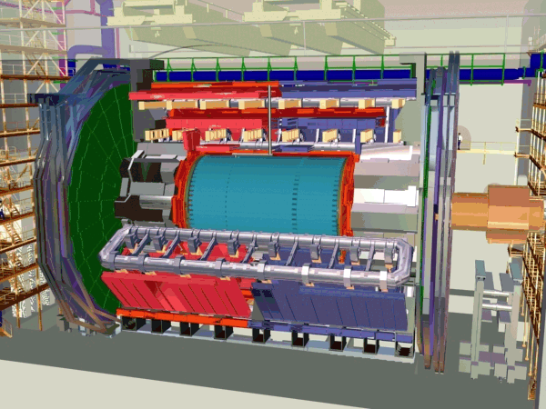
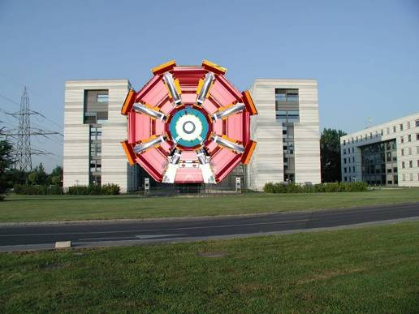
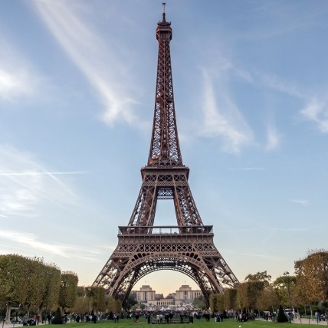
The ATLAS Detector
ATLAS is
… a detector capable of identifying the particles produced in pp collisions
~80m underground
As tall as a 7 storey building!
25m diameter
Total length 44m
Weight of 7000 Tons … Same as the wrought iron of:
©ATLAS, CERN

Slide 23
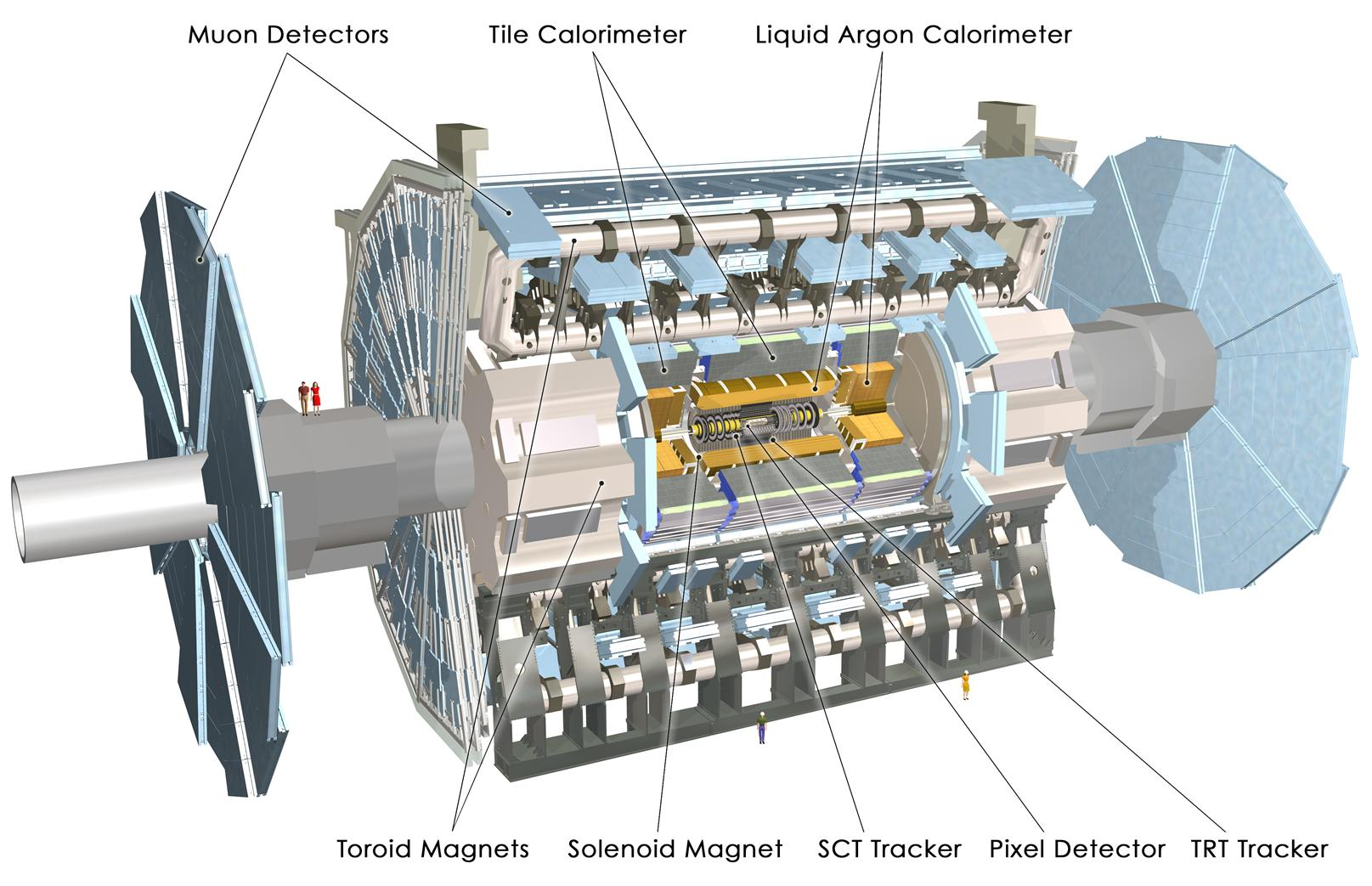
The ATLAS Experiment
Axial field provided by solenoid
(2T) in the central region
(momentum measurement)
High resolution silicon
detectors:
- 6 Mio. channels
(80 μm x 12 cm)
- 100 Mio. channels
(50 μm x 250 μm)
spatial resolution: ~ 15 μm
(in the azimuthal direction)
Energy measurement down to 1º to the beam line with a calorimeter system
Independent muon spectrometer (superconducting toroid system)

Slide 24
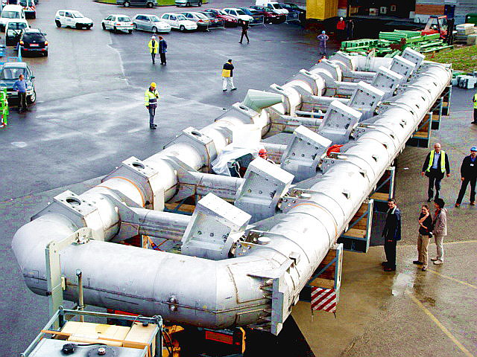
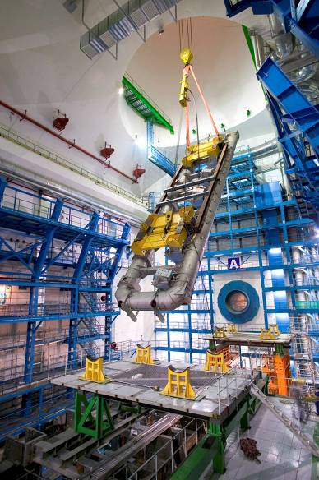
ATLAS detector construction and installation

Slide 25
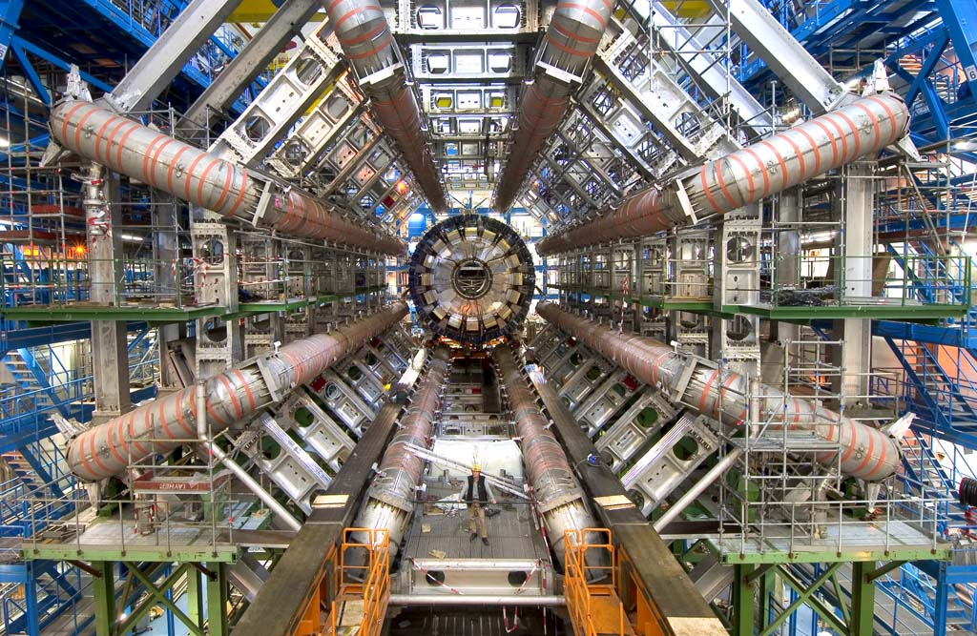

Slide 26
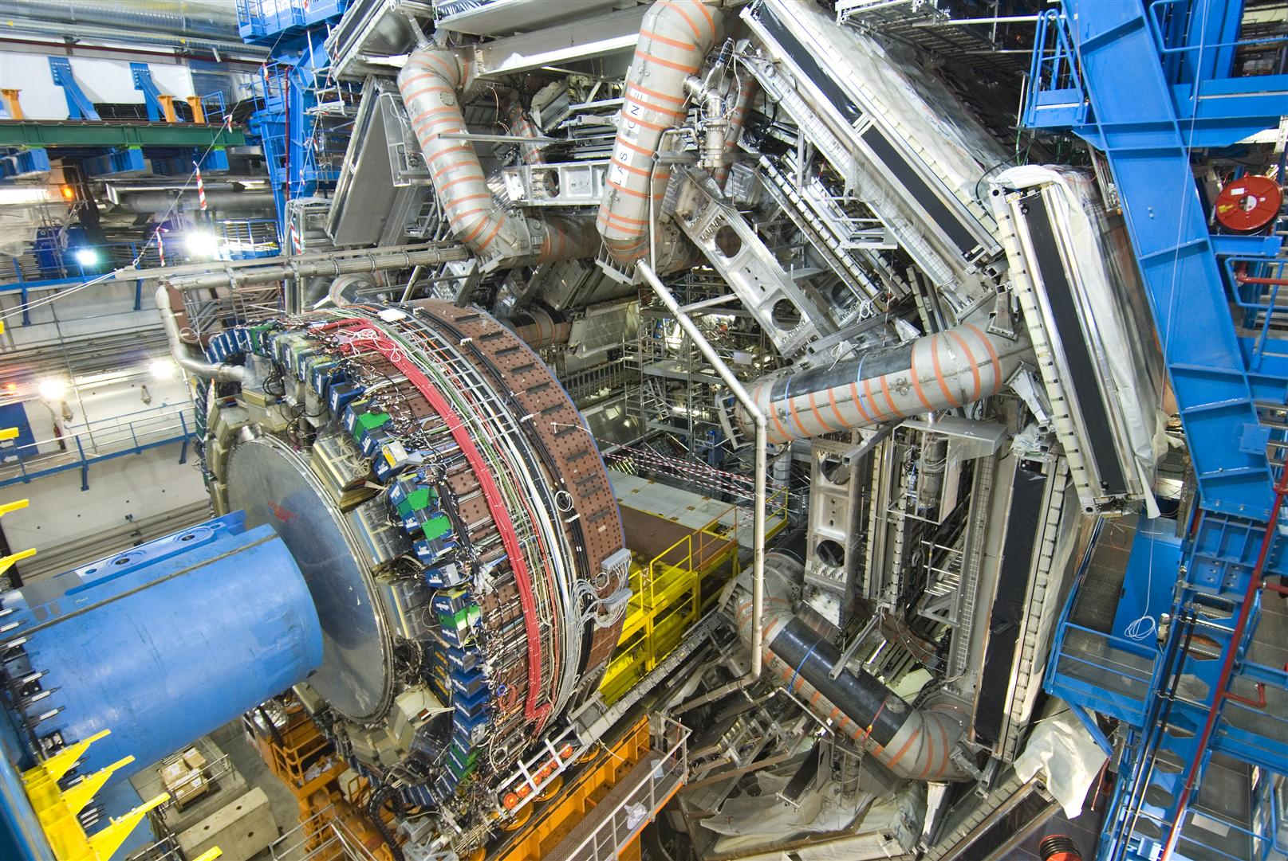
Encap calorimeters

Slide 27
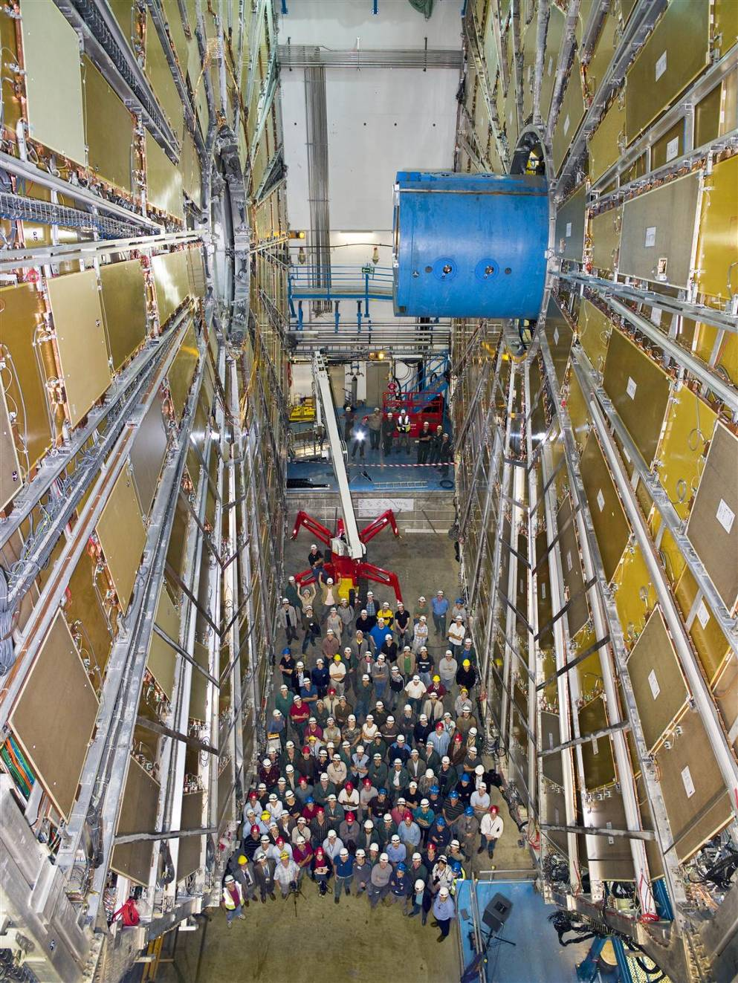
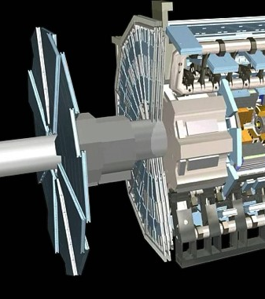
Muon detector system
In the forward region

Slide 28
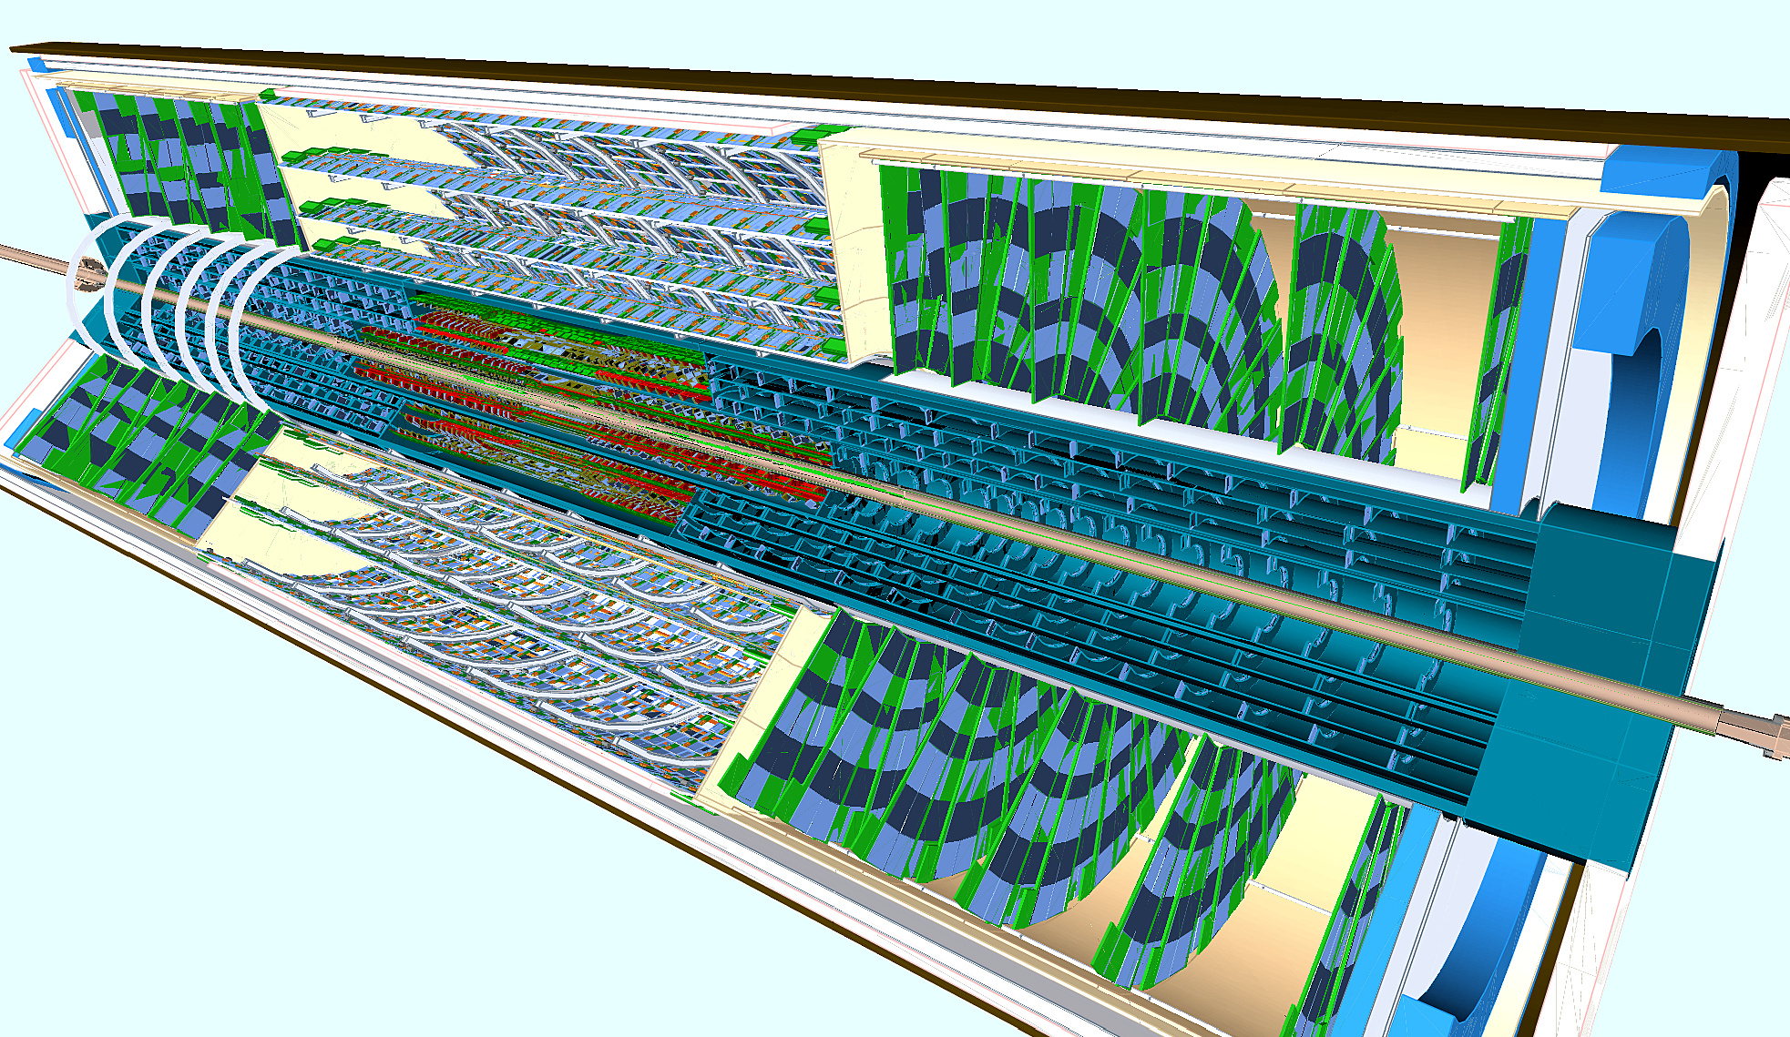
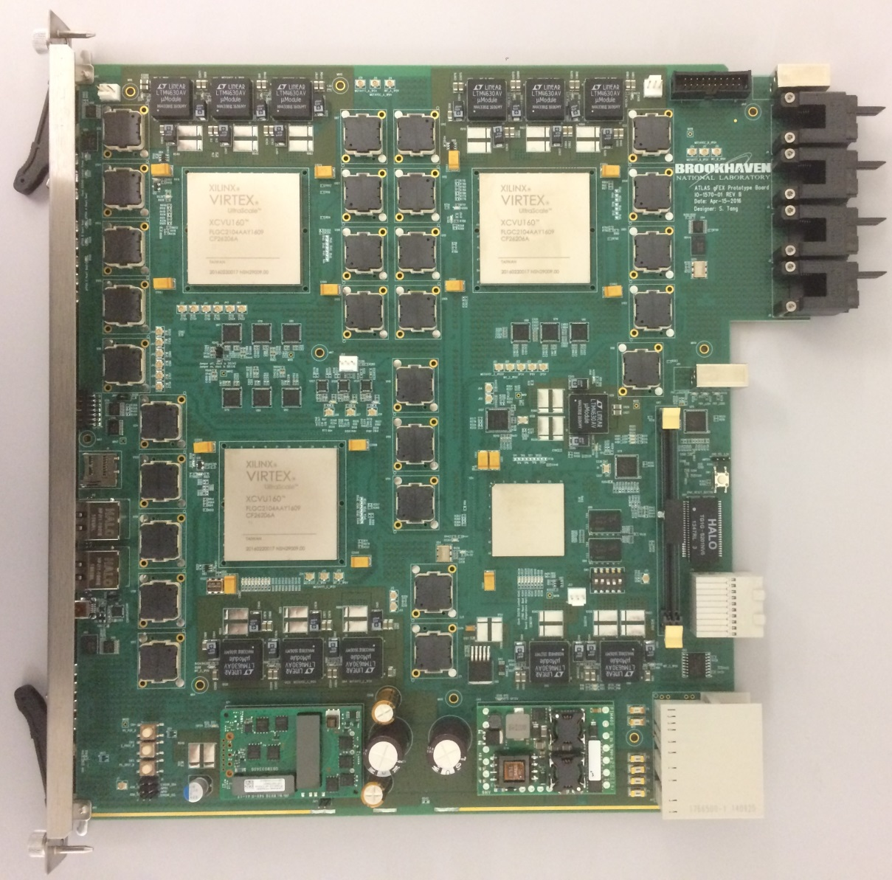
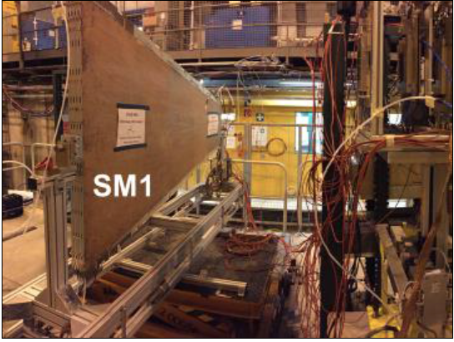
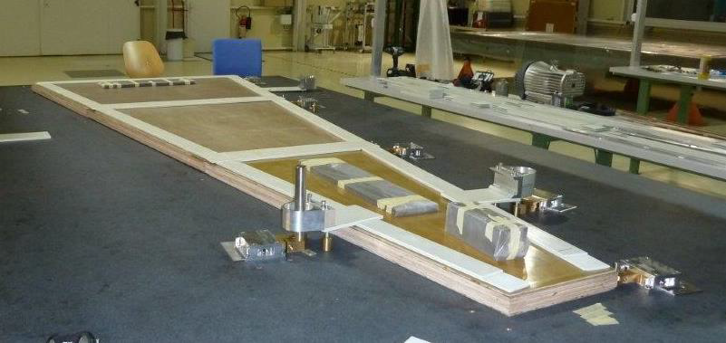
Detector Upgrade Projects
-Preparing the Future-

Slide 29
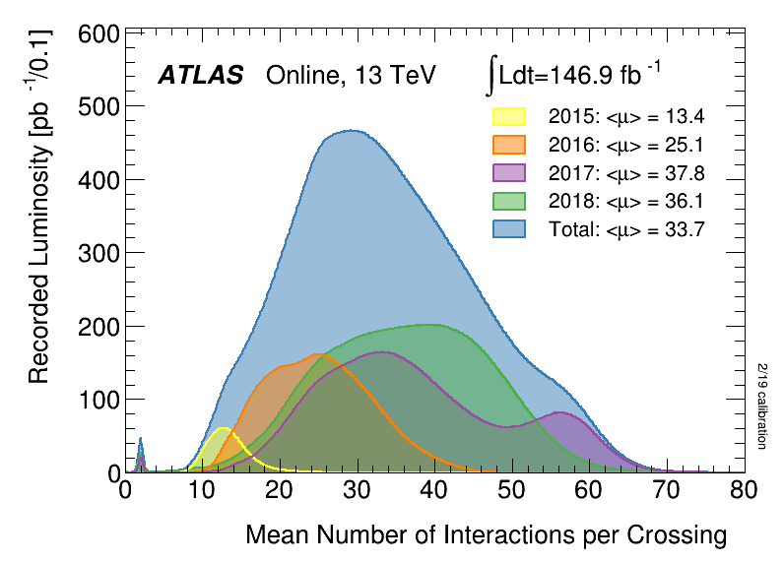
Run 3,4++ LHC Targets
2009
Run 1 LS1 Run 2 LS2 Run 3 LS3 Run 4-5…
(Phase 0) (Phase I) (Phase II)
2026 - 2037?
HL-LHC
2010 - 2013
2013-
2014
2015 2018
2019-
2020
2021-2023
2024-
2026
Run 3 (2021-2023) luminosity goals:
Run at design energy of 14TeV, instantaneous luminosity 2x10³⁴ cm⁻²s⁻¹.
More than double accumulated data (reach >300 fb⁻¹) before Long Shutdown 3
Run 4++ (2026-2037?) High-Luminosity LHC (HL-LHC) luminosity goals:
Access rare physics processes, search for new physics beyond the Standard Model
14TeV, ~ 3-4x increase in instantaneous lumi: 7.5x10³⁴ cm⁻²s⁻¹
Accumulate on average per year what we accumulated in all of Run 1-3
Reach up to ~4000 fb⁻¹ by ~2037
Accomplished by increasing <μ> to ~200 pileup events/bunch crossing (from avg of ~35)
The challenge:
?
<μ> = 200

Slide 30
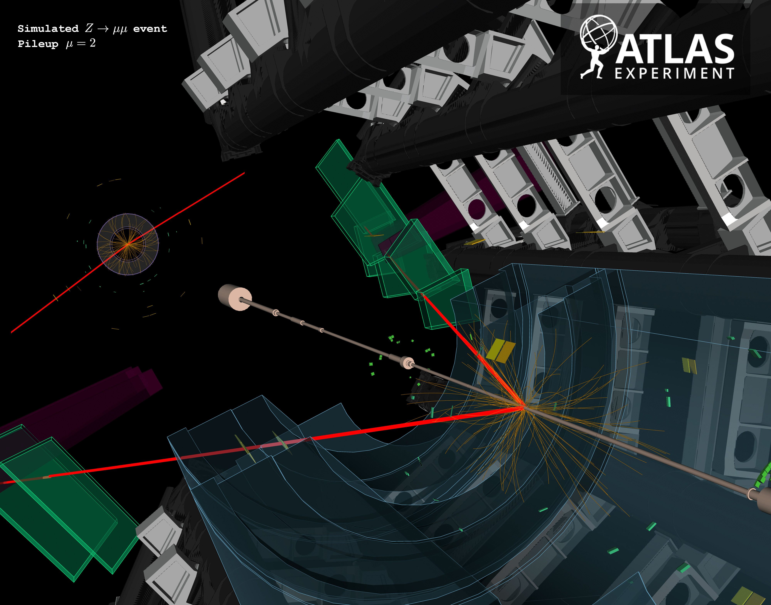
Simulated Z→μμ
μ=2
μ=50
μ=140

Slide 31
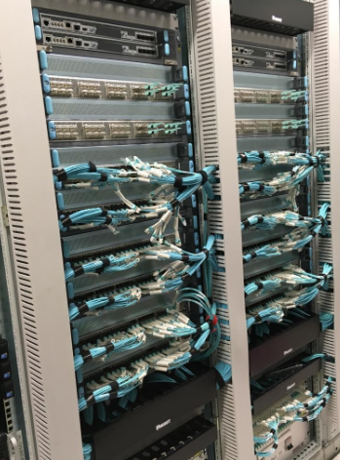
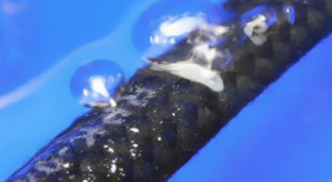




LS2 – activities
LAr: change cooling pipes of frontend crates
Release 22 preparations
New core routers for TDAQ
LUCID
RPC gas leak repairs
New MBTS &
crack counters

Slide 32



Largest Phase-I project: New Small Wheel
Small Wheel
Motivation:
Reduce muon fake trigger rate
Maintain good tracking efficiency at high
luminosity
Project is on a critical path for installation in LS2 :
Install NSW-A Aug 2020, NSW-C Christmas 2021/22(?)

Slide 33

Phase-II upgrade projects

Slide 34


This was Run 2…
Simulated ttbar event at <μ>=200 collisions per bunch crossing. The bottom-left: 2D r-z view of the interaction region. Vertical scale = 2.5mm & horizontal scale = 12cm. Tracks coming from the ttbar vertex are in cyan. Two secondary vertices and the tracks coming from them in yellow.

Slide 35



Largest Phase-II project: ATLAS Inner Tracker (ITk)
ITk Pixel TDR
ITk Strips TDR
Entirely replace the heart of ATLAS…
Strips
Pixels
~1m
~6m

Slide 36


A few Physics Highlights
Higgs boson
Discovery
H→ZZ→4l

Slide 37


Progress: example of the H➝ ZZ* ➝4l channel
Phys. Lett. B 716 (2012) 1-29
ATLAS-CONF-2019-025

Slide 38








Search for new high-mass resonances
q
$$\overline{q}$$
e⁺
e⁻
q
$$\overline{q}$$
e⁺
$\overline{ν}$
Z’
W’
arXiv:1903.06248
ll
Nature has
many “standard
candles”.
Why not more?
Combining the electron and muon channels:
Z’: excluded to ~4.5-5 TeV, depending on the model
e.g. E₆-motivated Grand Unification model &
Sequential Standard Model (SSM)
W’:
Resonances
High- mass DY
lν
arXiv:1906.05609
(SSM)

Slide 39












A taste of (some of) the results from the summer conferences
ATLAS-CONF-2019-034
ATLAS-CONF-2019-031
ATLAS-CONF-2019-027
The finalisation of the full Run-2 physics and performance publications prior to the restart of data-taking in Run 3 is an important goal for the Collaboration.

Slide 40

ATLAS is
… a collaboration of more than 5000 physicists/ students/engineers/technicians from ~40 different countries (>1000 PhD students!) working together
Map of the world showing in blue countries that have ATLAS member institutions. In green are countries that contain no ATLAS institutions but have ATLAS members that are citizens of the country.

Slide 41
Latin America
1.8%
Asia, Australia
6.2%
Africa
1.1%
Canada
3.5%
USA | 18,7%
Germany | 11,3%
UK | 10,2%
Italy | 9,0%
France | 7,4%
CERN | 5,6%
Japan | 4,1%
Canada | 3,5%
Russia+ JINR | 4,8%
Spain | 2,6%
China | 2,6%
Czech Republic | 2,1%
Sweden | 1,6%
Israel | 1,6%
Poland | 1,6%
Switzerland | 1,3%
Netherlands | 1,3%
Europe (others) | 6,0%
Asia (others) + Australia | 2,0%
Latin America | 1,8%
Africa | 1,1%
Japan
4.1%
USA
18.7%
Russia + JINR
4.8%
Germany
11.3%
Europe (others)
16.5%
UK
10.2%
CERN
5.6%
Italy
9.0%
France
7.4%
Fractions according to PhD physicists
(M&O share)

Slide 42


Recent data! Shown by Gordon Watts @ Berlin AOW. Evolution of demographics…
GEN-2019-001
Age distribution of men and women
Number of qualified authors
Fraction of women
Fraction of women by age

Slide 43


The ATLAS Community at CERN (i.e. YOU!)
The CERN environment is an inherently diverse one, given the international nature of the lab.
We value the celebration of this diversity as an important part of our identity as scientists.
In physics, diversity contributes to the excellence of our research and education.
including people with a variety of backgrounds, and opinions e.g. on technologies or analysis strategies enriches our community
The ATLAS Collaboration is made up of diverse members from around the globe with different age, gender, sexual orientation, gender identity, culture, physical ability, ethnicity, appearance, education or religious background.
Our goal is to keep ours a positive and inclusive community.
Welcome to our new members of ATLAS!
The ATLAS End-of-Year Party Wed 11 Dec 2019 18:00 in R2. Register.

Slide 44

The ATLAS Community at CERN
We follow the CERN code of conduct. This means that we abstain from and actively discourage all forms of harassment as well as verbal, non-verbal, written or physical abuse.
Yelling at someone to make your point is abusive.
Be mindful of the language that you use.
for example, sexual language and imagery, sexist, racist, or otherwise exclusionary jokes are not appropriate.
Give your colleagues the curtesy and respect that you would like to receive.
In meetings we welcome questions, which should be asked and answered respectfully, and pay particular attention to those new to the Collaboration. We want all participants to be able to express their opinions freely.
We kindly ask that all Collaboration members follow these principles

Slide 45













Our collaborative spirit
Publishing scientific results using ATLAS data requires a long, collaborative chain of human endeavour. For this reason, all ATLAS members are considered to be equal shareholders of our data. Our success depends on our engagement in ATLAS and on our collaborative spirit.
Construct, install, maintain, repair, calibrate, align, trigger, collect, store…
Proocess, reconstruct, cocrrect, simulate, measure, interpret, review…

Slide 46







Your Community
Early Career Scientists Board
The ECSB is a special advisory group dedicated to assisting the ATLAS Collaboration in building an
environment where full scientific potential of young scientists can be realised.
ecsb.web.cern.ch
Reina Camacho Toro Lesya Anna Horyn Dimitrii Krasnopevtsev Luigi Marchese
(Paris LPNHE) (Chicago) (Hefei) (Oxford)
Xingguo Li Stefan Richter Ana Peixoto
(DESY) (DESY) (Portugal 1-LIP)

Slide 47




Your Community
ATLAS Diversity and Inclusion Contacts
Act as contact for ATLAS members to discuss concerns related to diversity and inclusion.
twiki.cern.ch/twiki/bin/viewauth/Atlas/DiversityInclusion
Kate Shaw Sahal Yacoob Gordon Watts Pippa Wells
(Sussex) (Cape Town) (Seattle) (CERN)

Slide 48






ATLAS Management Team
March 2019 – February 2021
Spokesperson: Karl Jakobs
(Freiburg)
Deputy Spokespersons:
- Andreas Hoecker (CERN)
- Manuella Vincter (Carleton)
Technical Coordinator: Ludovico Pontecorvo (CERN)
Resources Coordinator: David Francis (CERN)
Upgrade Coordinator: Francesco Lanni (Brookhaven BNL)

Slide 49
Legislative branch of ATLAS
October 2019
Executive branch of ATLAS
(J. Masik )
(J. Catmore )
(R. Nikolaidou )
(K. Moenig)

Slide 50
Activity areas in ATLAS
As a Collaboration, we have to master many activities in parallel
In particular now, since in parallel to data taking/analysis, we are preparing
a massive detector upgrade programme for the future of the experiment at the
High-Luminosity LHC (HL-LHC)
An important message for your career:
Experimental Particle Physics is more than “just” doing physics analysis;
Get engaged in other areas, get a broad education, profit from the many opportunities
offered within the ATLAS Collaboration, in particular while staying at CERN
Your are welcome to join these activities
… and your contributions will be extremely valuable

Slide 51



atlas-collaboration.web.cern.ch
The ATLAS main webpage:
Look at the right sidebar to learn all about:
Recent calls for nominations
Documents in circulation
Recent public results
Look at the top left to get the Weekly Digest (also sent by email).
The Digest is one of our main communications channels. Please read it every week!

Slide 52




Your information in the Membership Database
Don’t forget to give your photo permission!
In a large collaboration such as ATLAS, photos serve as important visual identifiers.
Anne Elk
Anne.Elk@cern.ch
Physicist
Paleo U.

Slide 53


Welcome to the Collaboration!
The ATLAS experiment is a great place to be!
a flagship experiment of world's flagship collider programme: LHC!
We have taken less than 5% of the total data until the end of HL-LHC!
The best is yet to come!
Try to get a broad education, use the opportunities offered by the Collaboration
Working together with 3000 scientists is not always easy (lots of work, stress, competitive environment) but is often lots of fun!
It is a balancing act! We need to:
Finish the Run-2 analyses & prepare for Run 3
Finish Phase-I & deliver Phase-II upgrades
This is a LOT to absorb!
If you feel overwhelmed, there are people that you can talk to!
Group conveners, mentors, and a lot of people who were in your shoes just a few years ago…
Operations & maintenance
Upgrade
Physics output

Slide 54
M. Vincter, Version: Oct 17, 2019
Welcome to ATLAS!
• ATLAS secretariat: my team leader registers me and gets me a CERN computer account.
• Learn about ATLAS/CERN at Weekly Meeting, at ATLAS Collaboration Weeks, in the CERN Bulletin.
• Your info in the GLANCE membership database.
• Early Career Scientist Board and joining e-groups.
I am ready to work on ATLAS!
• Coming to CERN for the first time: what you and your team leader need to do and to know; CERN Users’ Office, hostel, health insurance, visa info
• Induction Day and Software Tutorial (3x/year).
• Qualification Tasks & the path to Authorship.
• What are Class-1,2,3 OTP tasks?
• Physics and Performance Weeks & workshops.
I am ready to become a qualified author!
• Final steps to qualification.
• Authorship rights and responsibilities.
• Giving talks at national and international conferences. Speakers’ Committee FAQ. Rules for students and postdocs presenting their work.
• Get picked to give an ATLAS conference talk: SCAB ranking and profile.
• Selecting black-out dates, topics, and preferred conferences with SCAB db.
• Operations involvement with the OTP tool.
I am ready to publish my first paper!
• ATLAS publication policy, PubCom, submit notes in CDS, style guide, your papers via the GLANCE database, publication steps, Physics Office, arXiv, HepData.
• Postdoc participation in edboards is welcome. Tell you team leader!
I am graduating/moving on to my next job!
• Guidelines for your thesis.
• Upload your thesis in CDS.
• Resources for job hunting: in ATLAS, outside ATLAS, in CMS, InspireHEP.
• Guidelines for job talks: what can I show?
• Sniff! You are leaving ATLAS? ATLAS change of status, CERN change of status.
CERN clubs, Restaurant 1, Child care, CERN market, CERN shuttle to/from airport, Private accommodations, Public transport.
Diversity and Inclusion in ATLAS, Early Career Scientist Board (ECSB) , CERN Code of Conduct, Medical care, CERN ombuds.

